Slide 2
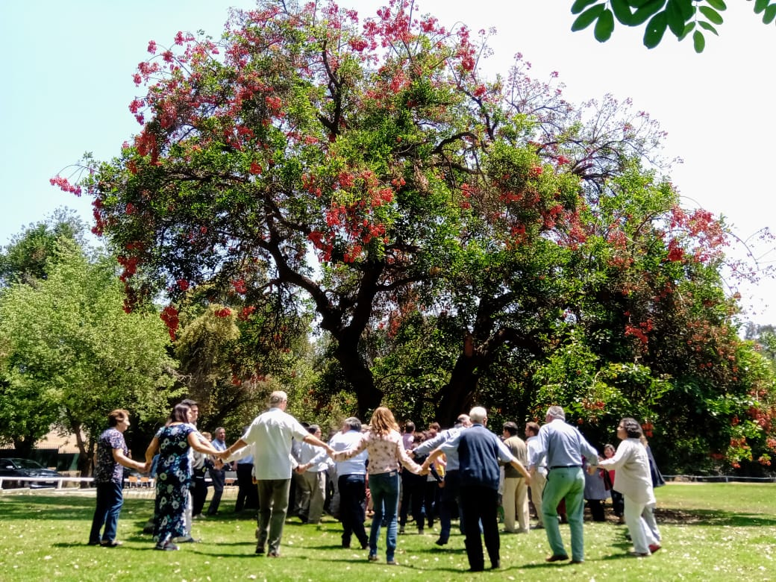
International Forum on the Lay Marist Vocation
WELCOMING, NURTURING, LIVING AND SHARING OUR VOCATION
"Your sons and daughters shall prophesy" (Joel 3, 1)

Slide 3
The objectives we want to achieve
To deepen our understanding of the Marist vocation with particular emphasis on the lay Marist vocation.
To review and offer formation and mentoring pathways for laypeople to grow in their vocation.
To reflect on and propose possible ways of making a formal commitment to the Marist charism.
To know, reflect, explore and propose possibilities of juridical structures (civil and canonical) for Marist laypeople

Slide 4
GENERAL PROCESS FORUM IN STAGES
Time for dialogue and discernment of the
3 provincial representatives and thematic teams
3 STAGE
International Forum
in Person
November 2022
5 STAGE
International Forum
Virtual
November 2024
Keys: Process
2 STAGE
Local meetings
of the AUs
(presencial o virtual)
July 2021 to June 2022
CONCLUDING
DOCUMENT
Presentation to
the General
Council and
General Chapter
4 STAGE
Reflection and analysis
(Work groups and
proposals)
Consult the Provincial
Laity Teams
if required..
December 2022
to June 2024
1 STAGE
Launch and
Organization
of the AUs
March to June 2021
Tiempo de diálogo
y discernimiento en
cada UA
STAGE
PREPARATION
Since
October2020
SEC. LAY PEOPLE: PERMANENT VIRTUAL ACCOMPANIMENT TO THE ADMINISTRATIVE UNITS

